Slide 1
Binary Neural Networks — Introduction and Hardware Implementation
Changchun Zhou
Peking University Shenzhen Graduate School
Shenzhen, China
November 19, 2018
Notes:
二值化神经网络的结构，怎么从一般的神经网络转化成二值化的，硬件是如何发挥这个特性来实现加速的

Slide 2
Outline
I
II
XNOR-Net
Neural Networks challenges
III
Bit Fusion
IV
Thinker-II

Slide 3
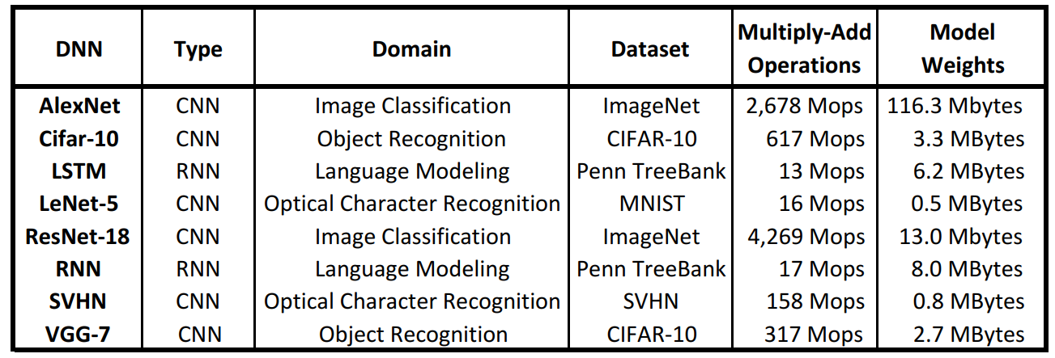
Neural Networks challenges
Significant computation
AlexNet has 720M FLOPS
storage capacity
AlexNet has 61M parameters (249MB of memory)
VGG-16 has 138M parameters (528MB of memory)
Computational power
Speed
Notes:
广泛应用，高精度是依托于大规模的模型，大量计算，可以看到图。。
带来功耗增加，由于硬件的限制，速度降低，这些都是神经网络应用实际生活的瓶颈

Slide 4



Aplication Issues
Computer vision
Automatic drive
Natural language process
Speech recognition
Mobile devices
Cell phones
Wearable devices
Notes:
应用场景图片
比如自动驾驶，要求实时性，突发情况的及时性，速度要求高，延时低
便携电子，容量有限，有限的电池容量无法支持神经网络的大规模运算

Slide 5
Binary Neural Networks
Urgent need for small, efficient and fast NNs
32-bit full precision may be redundant
Quantization with the extreme scenario +1, -1
Notes:
已经有许多论文量化到8bit ,

Slide 6
Outline
I
II
XNOR-Net
Neural Networks challenges
III
Bit Fusion
IV
Thinker-II

Slide 7
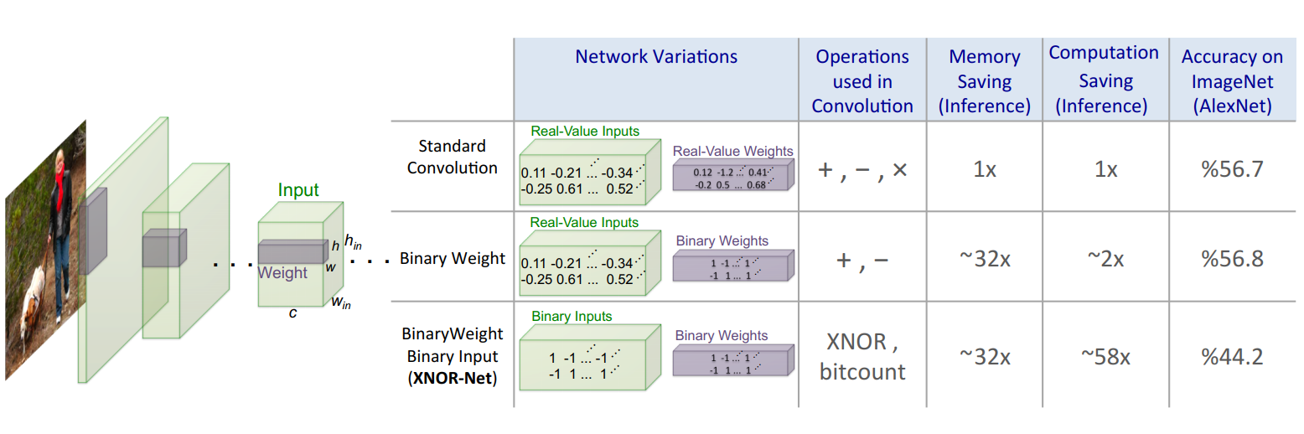
XNOR-Net
Top-1
Why XNOR + bitcount approximates MAC?
What if 0 replaces -1 ?
Rastegari M., Ordonez V., Redmon J., Farhadi A. (2016) XNOR-Net: ImageNet Classification Using Binary Convolutional Neural Networks. In: Leibe B., Matas J., Sebe N., Welling M. (eds) Computer Vision – ECCV 2016. ECCV 2016. Lecture Notes in Computer Science, vol 9908. Springer, Cham
Courbariaux, M., Bengio, Y.: Binarynet: Training deep neural networks with weights and activations constrained to +1 or -1. CoRR (2016)
Notes:
Bitcount？

Slide 8
XNOR-Net
What if 0 replaces -1 ?
A = 10010
B = 01111
0 is really -1 here
Dot product:
A * B = -3
XNOR(A, B) = 00010
Popcount P of 00010 = 1
-3 is clearly != 1
Additional step:
Result = 2*P - N

Slide 9

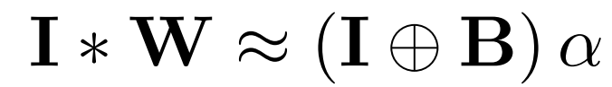
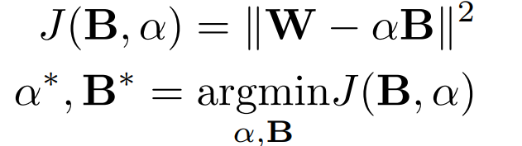

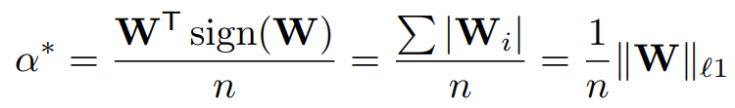
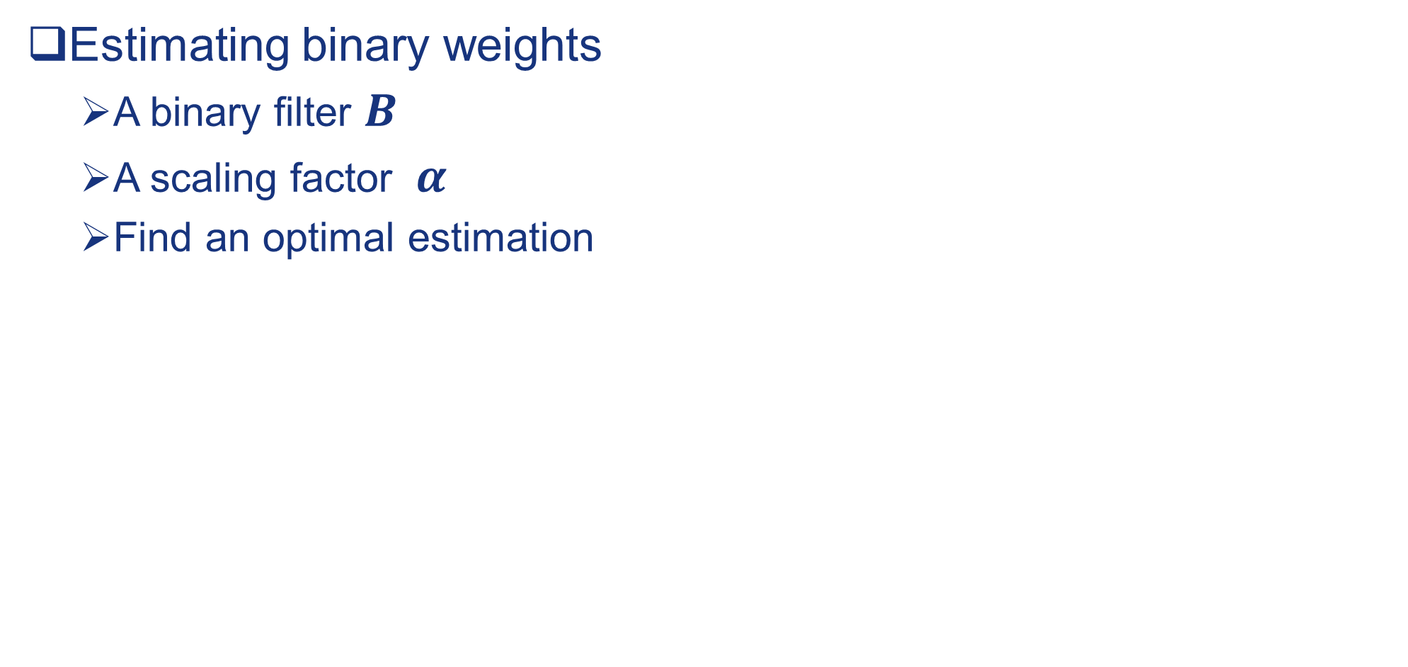
Binary-Weight-Networks[1]
Estimating binary weights
A binary filter $B$
A scaling factor $α$
Find an optimal estimation
norm(x, 1)
Notes:
放大因子是关键，更加接近于真实数，取的平均

Slide 10
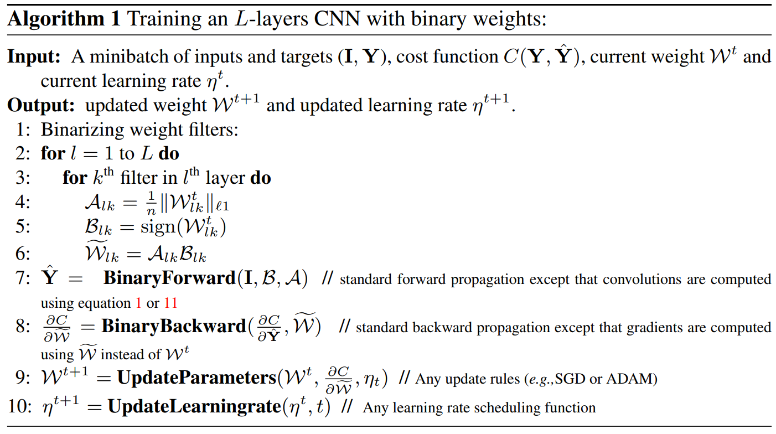
Binary-Weight-Networks[2]
Training Binary-Weight-Networks
Binarize the weight filters
forward propagation
backward propagation
Notes:
SGD ADAM

Slide 11

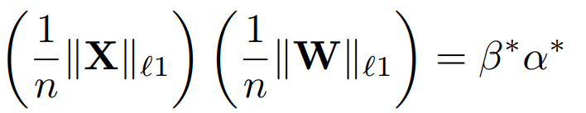
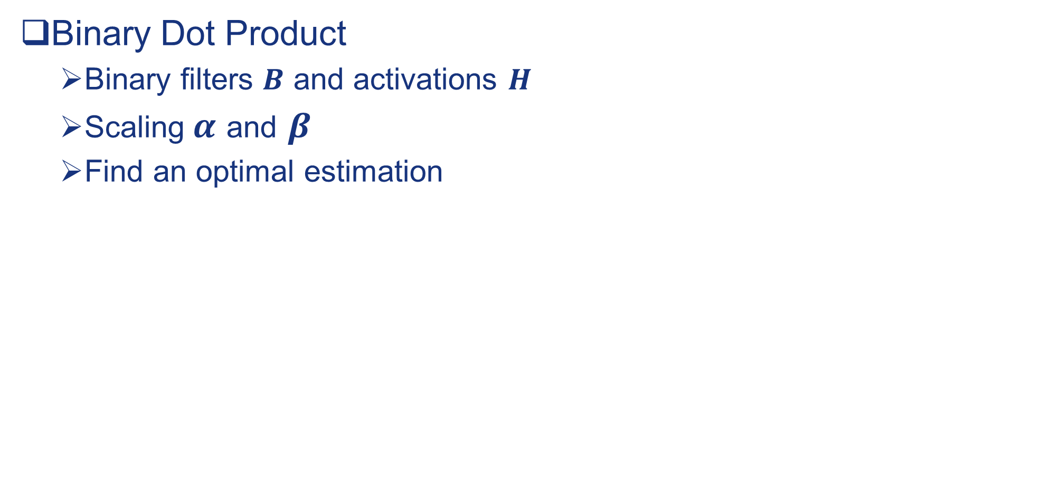
XNOR- Networks[1]
Binary Dot Product
Binary filters $B$ and activations $H$
Scaling$α$ and $β$
Find an optimal estimation

Slide 12
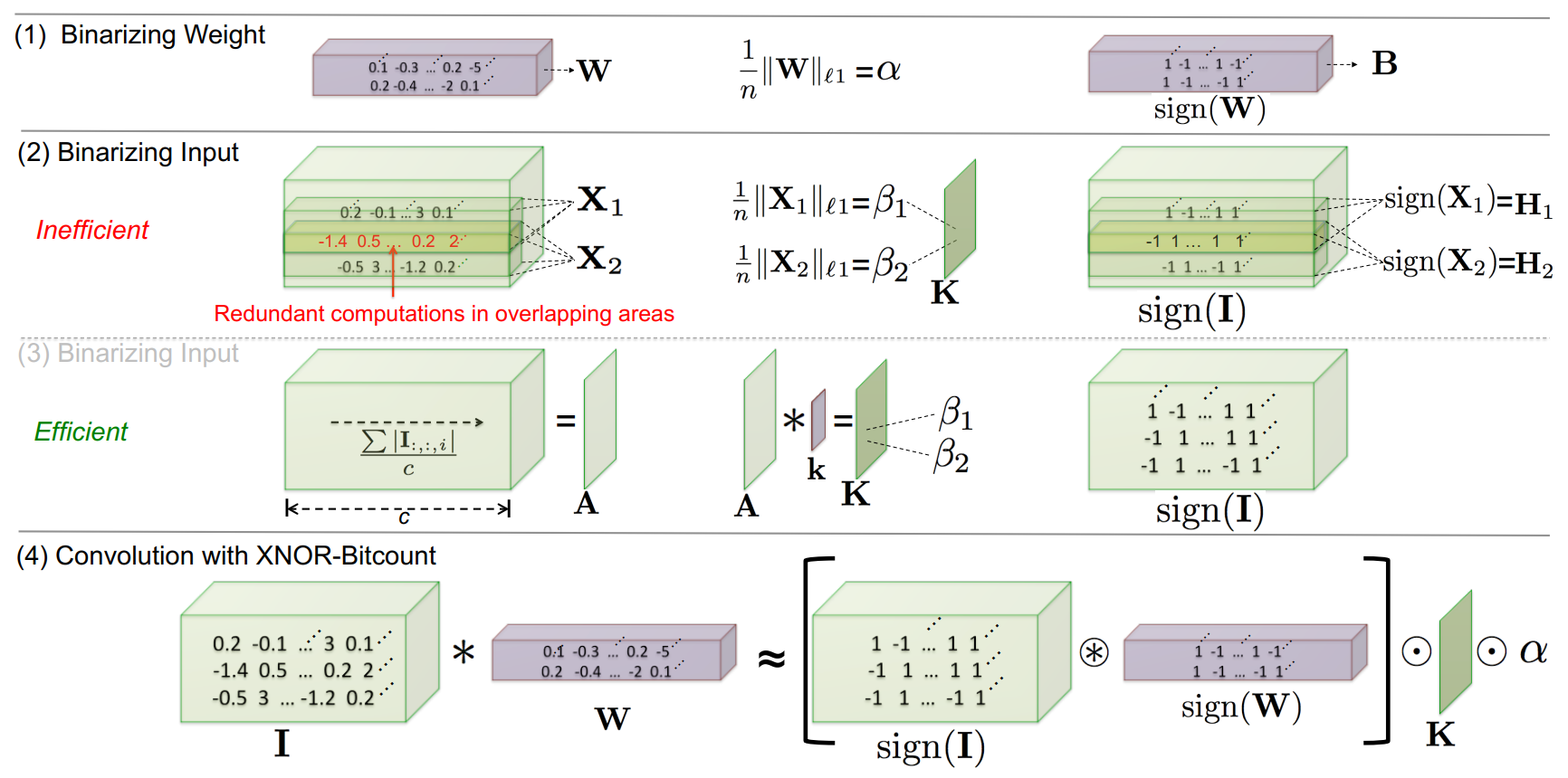
XNOR- Networks[2]

Slide 13

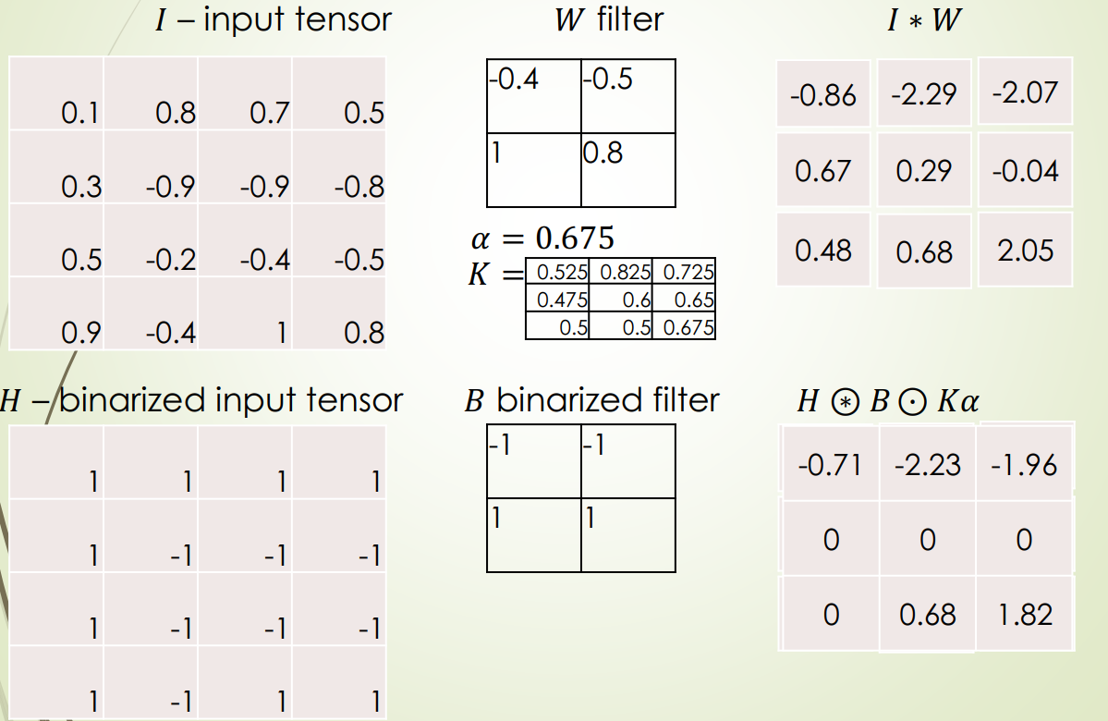
XNOR- Networks[3]
XNOR-Net Convolution Example
For example

Slide 14
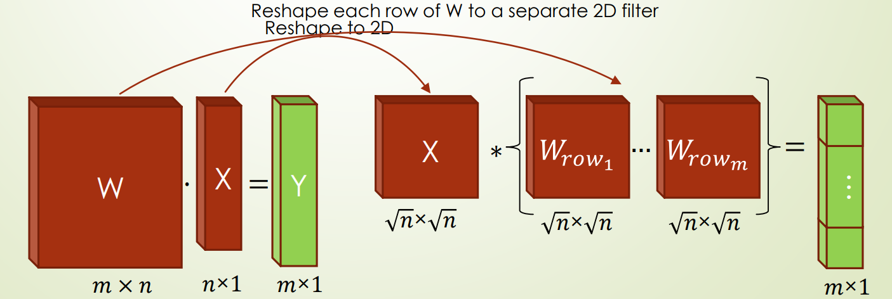
XNOR- Networks[4]
Binary Convolution
Overcome redundancy using a matrix A
Mainly using binary operations
FC → CONV

Slide 15
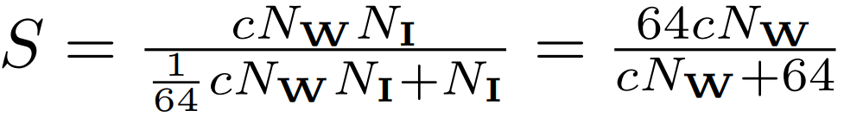
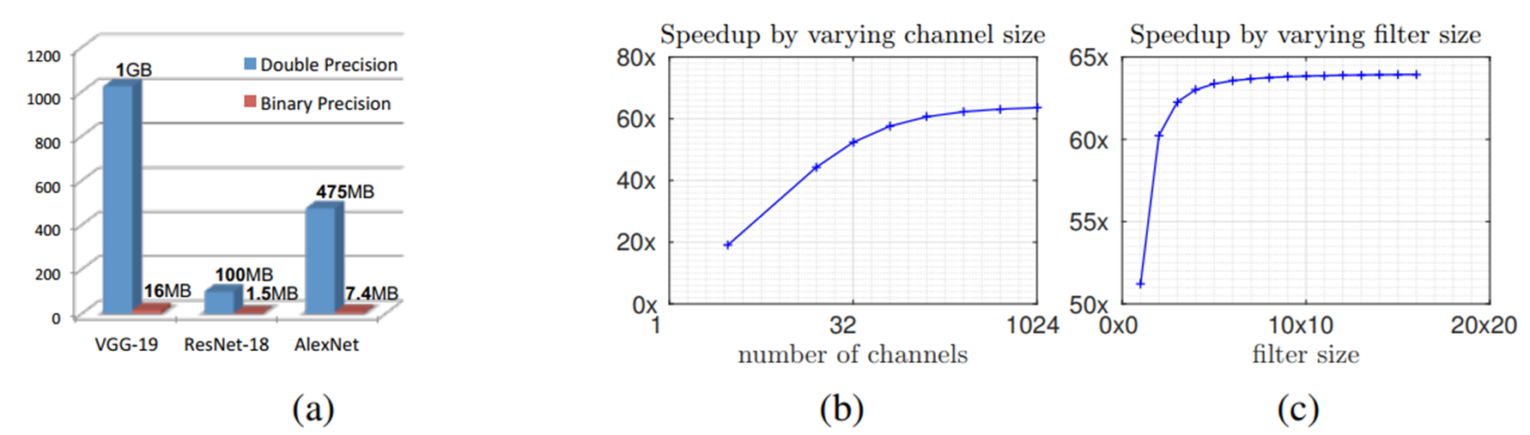
Experiments [1]
Efficiency Analysis
The larger the channel size and filter size, the higher the speedup
Avoid binarization at the first and last layer of a CNN
The CPU performs 64 binary operations in one clock
ResNet
Binary-weight-networks are so small that can be easily fitted into portable devices

Slide 16
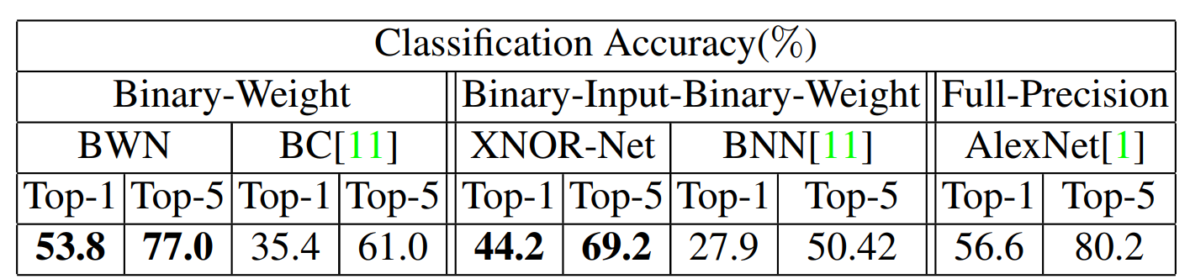
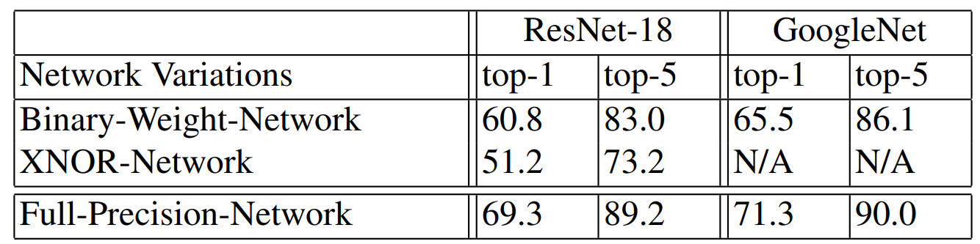
Experiments [2]
Image Classification on ILSVRC2012
Notes:
第一次输入 input没有二值化
The binarization method and the network structure are different
BWN use the deterministic binarization
Binarization : the optimal scaling factors
Block structure: B-A-C-P
B-A-C-P ：batch activation conv pool

Slide 17
Conclusions
Try binarization on large datasets
Two new variations tested on ImageNet:
Binary-Weight-Nets <bin weights only>
XNOR-Nets <bin. weights & inputs>
Lower memory (relative to full-precision)
Higher accuracy (relative to former binary methods)

Slide 18
Outline
I
II
XNOR-Net
Neural Networks challenges
III
Bit Fusion
IV
Thinker-II

Slide 19
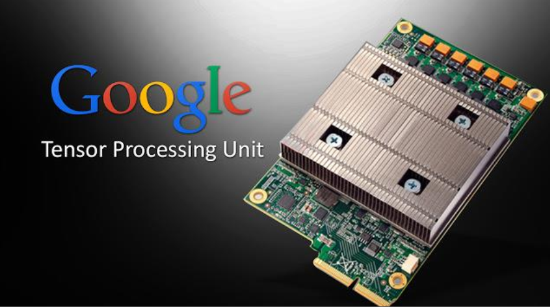
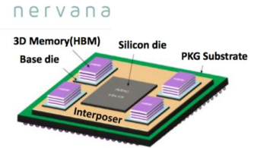
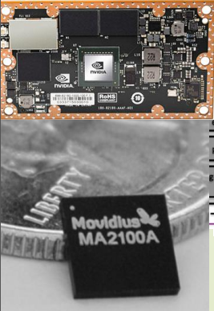
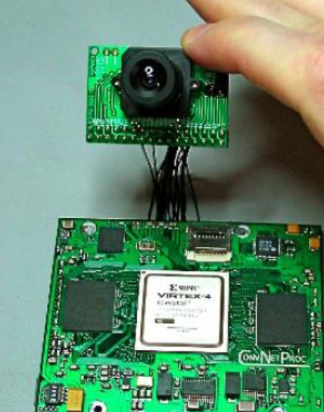
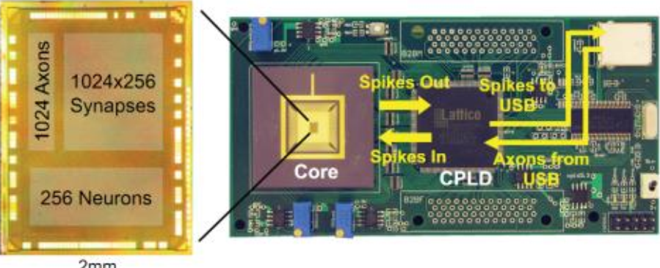
Hardware Implementations

Slide 20
The basic starting points
The bit width varies significantly across DNNs and layers
Bit-level processing elements fuse to match the bit width
A multiply operation can be decomposed to 2-bit multi-plications.
H. Sharma, J. Park, N. Suda, L. Lai, B. Chau, J. K. Kim, V. Chandra, H. Esmaeilzadeh, "Bit Fusion: Bit-Level Dynamically Composable Architecture for Accelerating Deep Neural Networks", ISCA, 2018.
Notes:
一种硬件跑不同网络，但是每个网络的位宽不一样。即使是每层也可以不一样

Slide 21
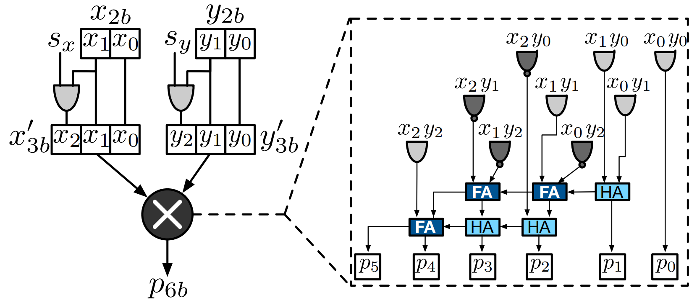
Bit Fusion MicroArchitecture[1]
BitBrick (BB) Microarchitecture
Create 3-bit sign extended operands
Employ a 3-bit signed multiplier to generate a 6-bit product

Slide 22
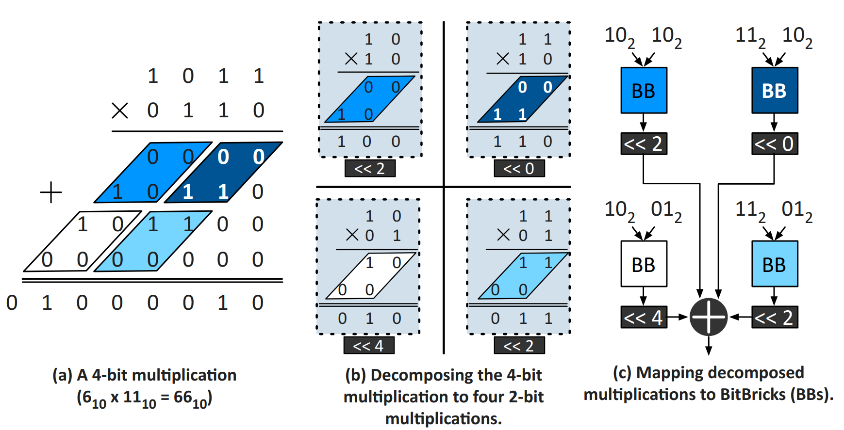
Bit Fusion MicroArchitecture[2]
Maps multiply-add operations with varying bitwidths to BitBricks
Use BitBricks to execute 4-bit multiplications

Slide 23
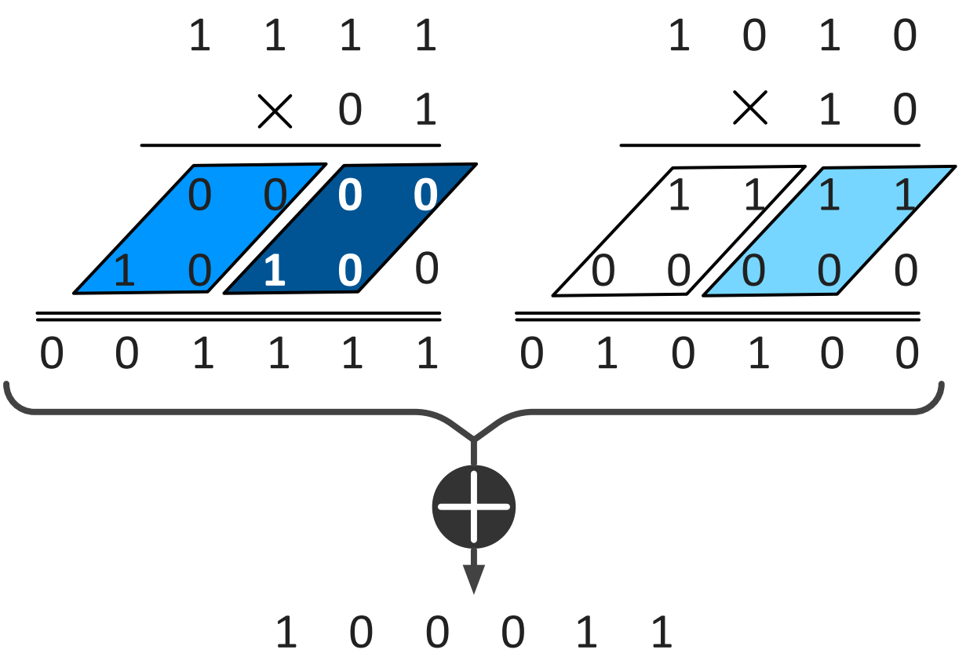
Bit Fusion MicroArchitecture[3]
Maps multiply-add operations with varying bitwidths to BitBricks
Two 4-bit × 2-bit multiplications decomposed to four 2-bit multiplications
The performance at 4-bit×2-bit is twice that of 4-bit×4-bit
Dynamically fused together to support a range of bitwidths
A significant increase in parallelism when operating at lower bitwidths

Slide 24
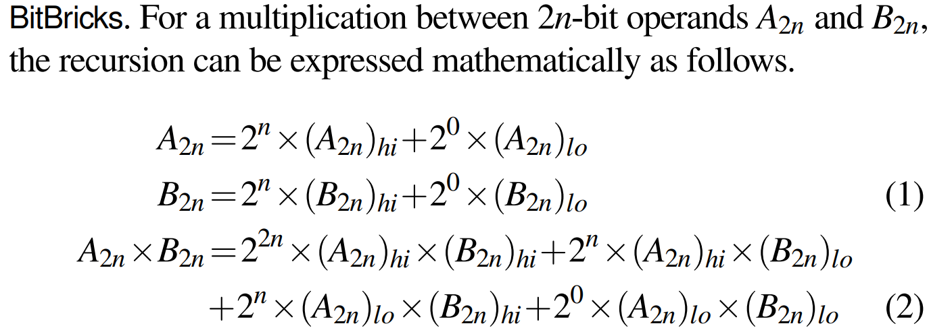
Bit Fusion MicroArchitecture[4]
The mathematical property:
A multiply operation can be decomposed to 2-bit multi-plications.

Slide 25
Bit Fusion MicroArchitecture[5]
Fusion Unit Micro-Architecture
Temporal design
The area of the shifter and accumulator depends on the highest bitwidth (16-bit for BF, 90% of the area, shift 16-bit)
Spatial fusion
Use a shift-add tree and a single shared accumulator
The shift-add tree consists of three shift-units and a four-input adder

Slide 26
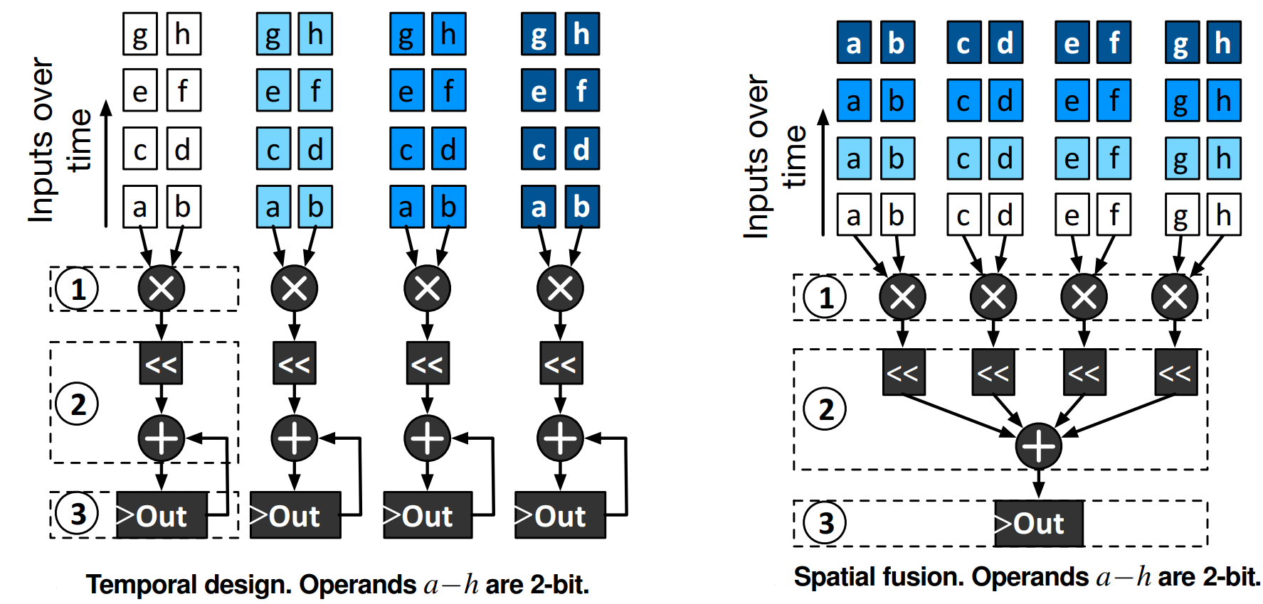
Bit Fusion MicroArchitecture[6]
Fusion Unit Micro-Architecture

Slide 27
Bit Fusion MicroArchitecture[7]
Fusion Unit Micro-Architecture
Spatial fusion with 64 BitBricks would pack the highest number of BitBricks
But 128-bit wide access to the SRAM buffers, increasing the area
Must make a tradeoff
Combine16 BitBricks spatially to realize support up to 8-bit operands
Combine it with temporal design to support up to 16- bit operands over four cycles.

Slide 28
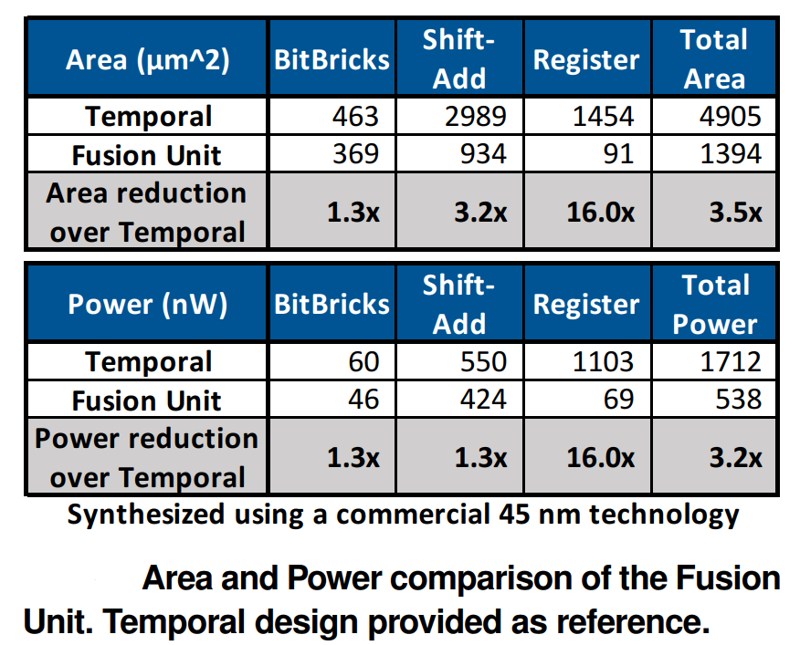
Bit Fusion MicroArchitecture[8]
Fusion Unit Micro-Architecture

Slide 29
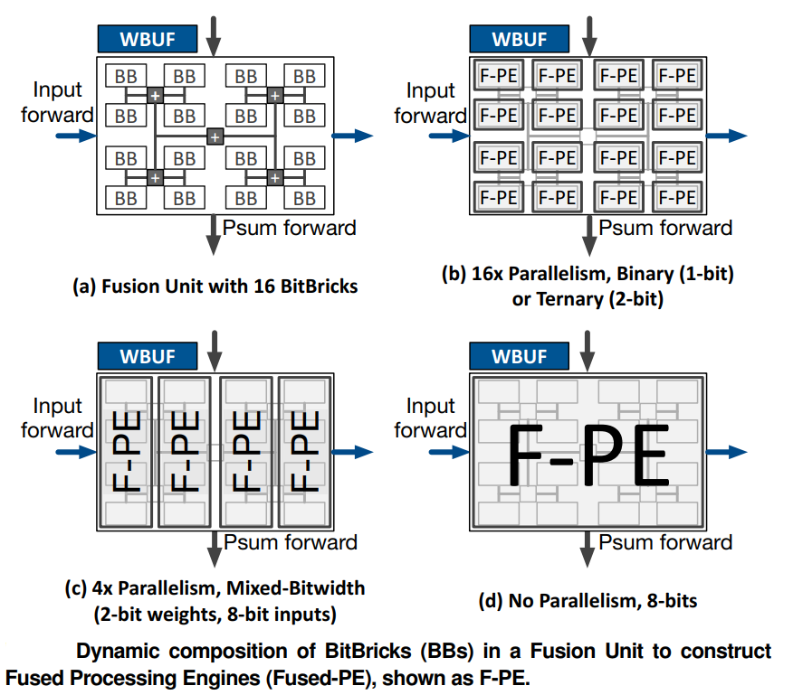
Bit Fusion Architecture[1]
Different ways of logically fusing BitBricks

Slide 30
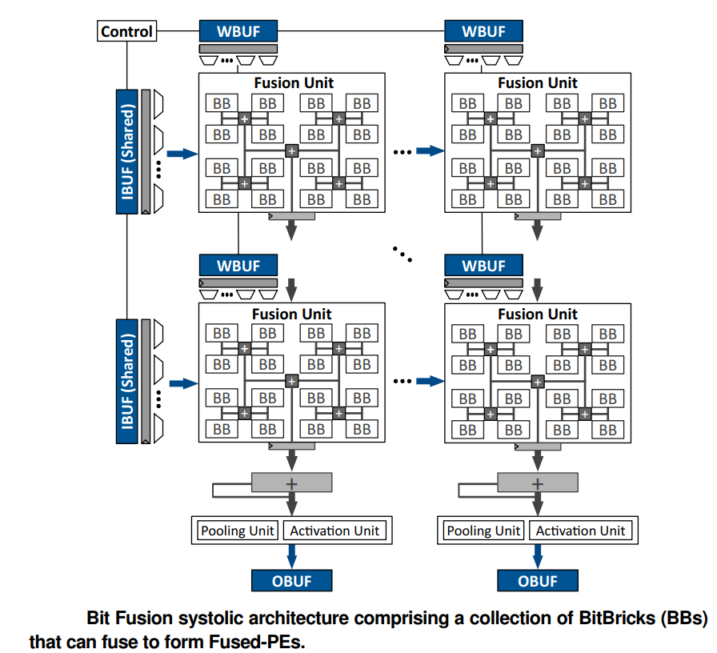
Bit Fusion Architecture[2]
Accelerator Organization
Minimize the overhead of control
Maximize data reuse
Enforce sharing of input data
Accumulates partial results
Minimize access to on-chip memory
Notes:
动画

Slide 31
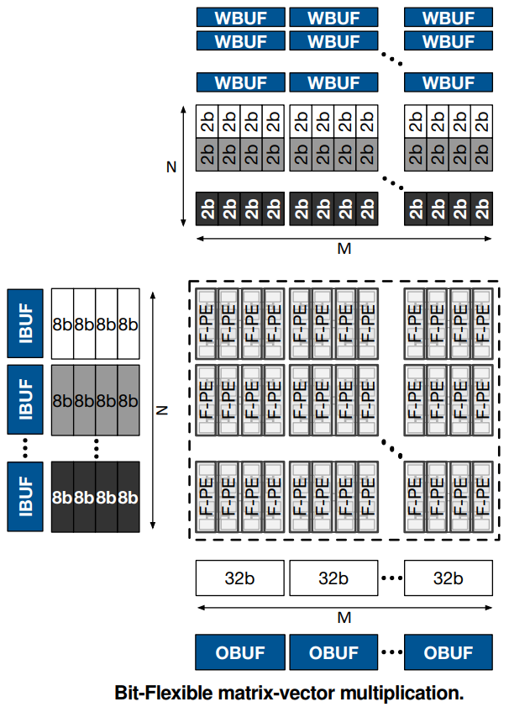
Bit Fusion Architecture[3]
Bit Fusion Execution Model
Buffers provide 32 bits per access
The input values are shared across each row
Weights values are specific to each Fused-PE
The lower bitwidth of weights
increase 4x the level of parallelism
reduce by 4x accesses to the weight buffer
Notes:
框出Fusion Unit
Input weight PE内部和加上psum向下传

Slide 32
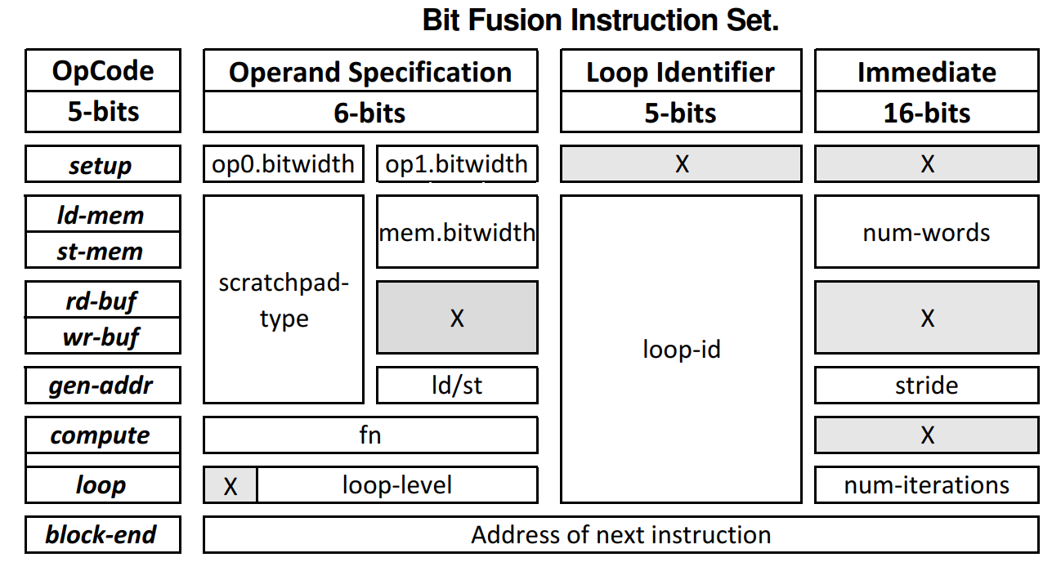
Instruction Set Architecture
Enable a flexible data-path for Bit Fusion
Block-structured ISA for DNN layers
The fusion configuration of the BitBricks is fixed in each block

Slide 33
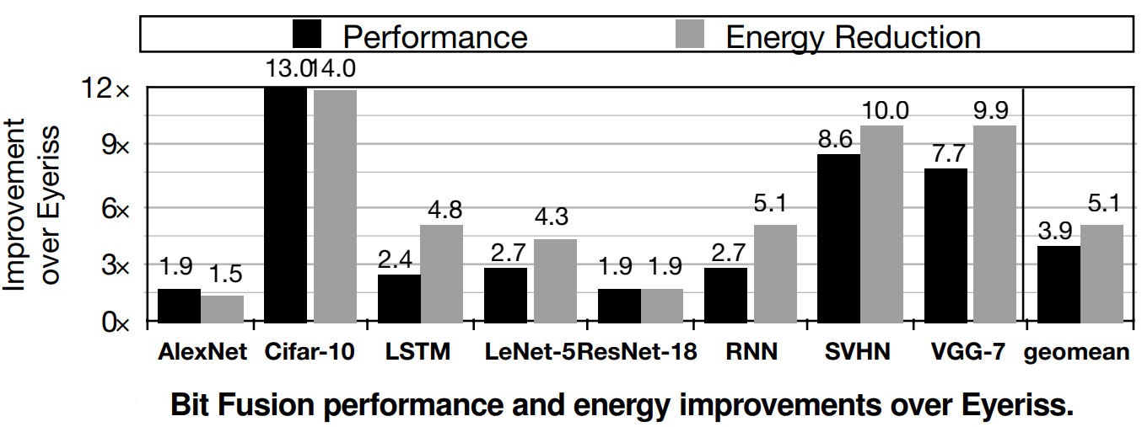
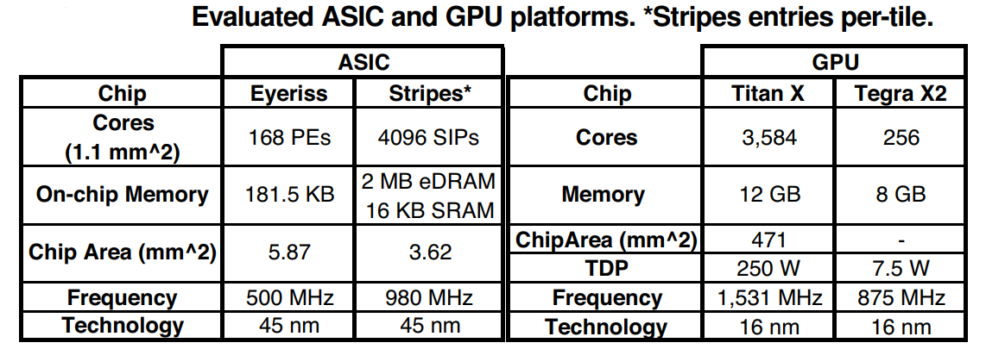
Experimental Results[1]
Comparison to Eyeriss
RTL-simulations, synthesize at 45nm, Synopsys Design Compiler
Cifar-10 with 1-bit input and weight
Y. H. Chen, T. Krishna, J. S. Emer, V. Sze, "Eyeriss: An Energy-Efficient Reconfigurable Accelerator for Deep Convolutional Neural Networks", IEEE Journal of Solid-State Circuits, vol. 52, no. 1, pp. 127-138, 2017.
P. Judd, J. Albericio, T. Hetherington, T. M. Aamodt, and A. Moshovos, “Stripes: Bit-serial deep neural network computing ,” in MICRO, 2016.
Notes:
实验条件

Slide 34
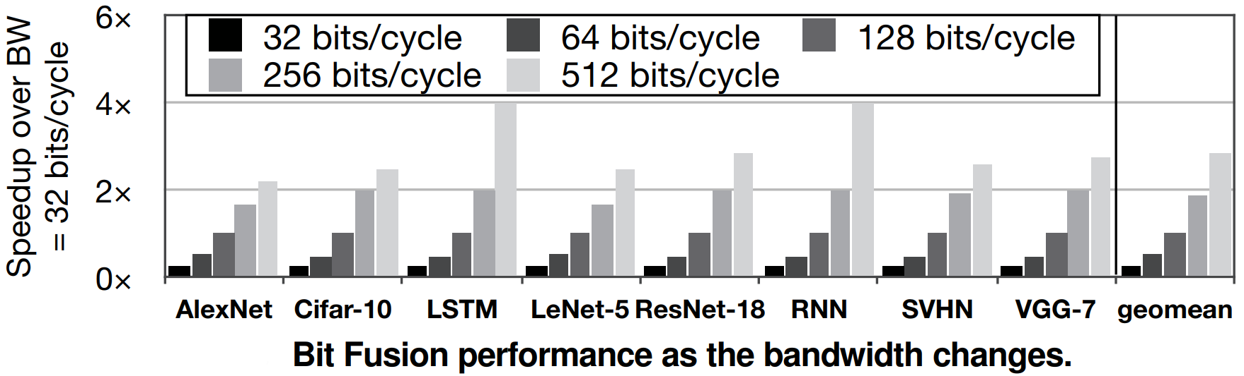
Experimental Results[2]
Sensitivity Study
Sensitivity to memory bandwidth
On average, 4x bandwidth, 1.6x speedup
RNN benchmarks are more sensitive

Slide 35
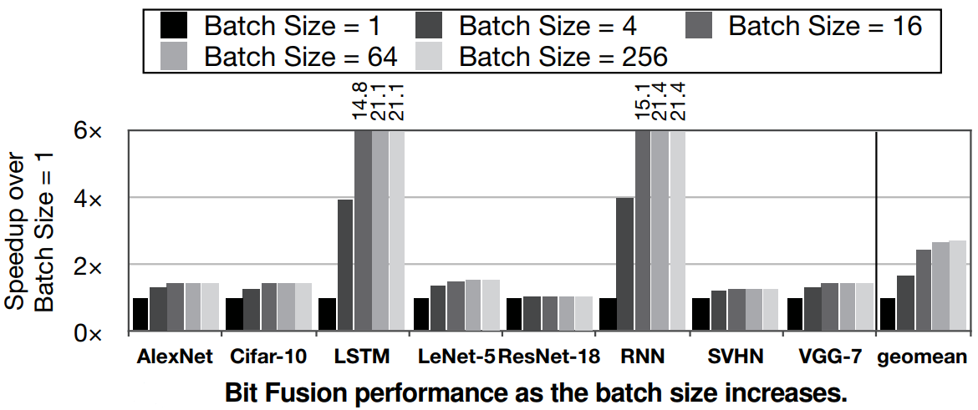
Experimental Results[3]
Sensitivity to batch size
Batching amortizes the cost of weight reads by sharing weights across a batch of inputs
Batching is effective when the bandwidth is limited and the performance is bandwidth-bound
Notes:
怎么理解解释？ Batch size

Slide 36
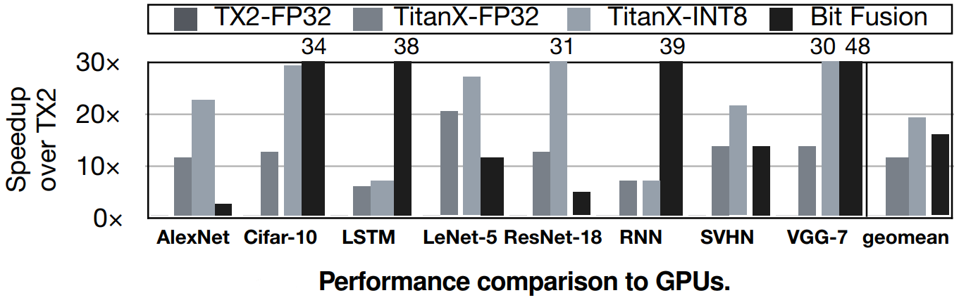
Experimental Results[4]
Comparison to GPUs
Bit Fusion can extract performance benefits for as low as 2-bit operations
Bit Fusion consuming 895mW match the 250W Titan-INT8

Slide 37
Outline
I
II
XNOR-Net
Neural Networks challenges
III
Bit Fusion
IV
Thinker-II

Slide 38
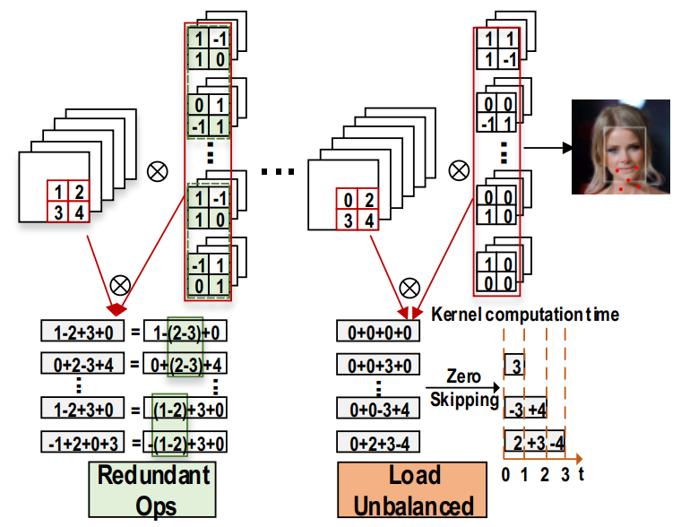
Low-bit NNs Issues
Traditional index based methods need extra high memory cost limited by the index value range
The sparsity of weights and activations is prominent
Identical and redundant operations
Large relevance
Notes:
所有都是对于low-bit NNS而言

Slide 39
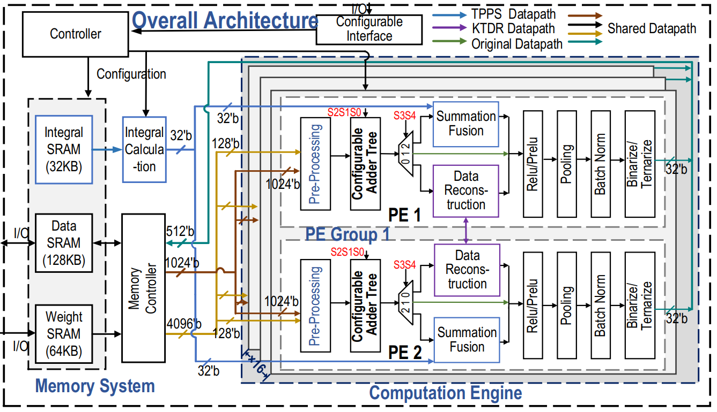
Overall architecture[1]
The overall architecture consists of computation engine, configurable interface, controller , and on-chip memory
Configure working mode through S0-S4
32 PEs divided into 16 groups

Slide 40
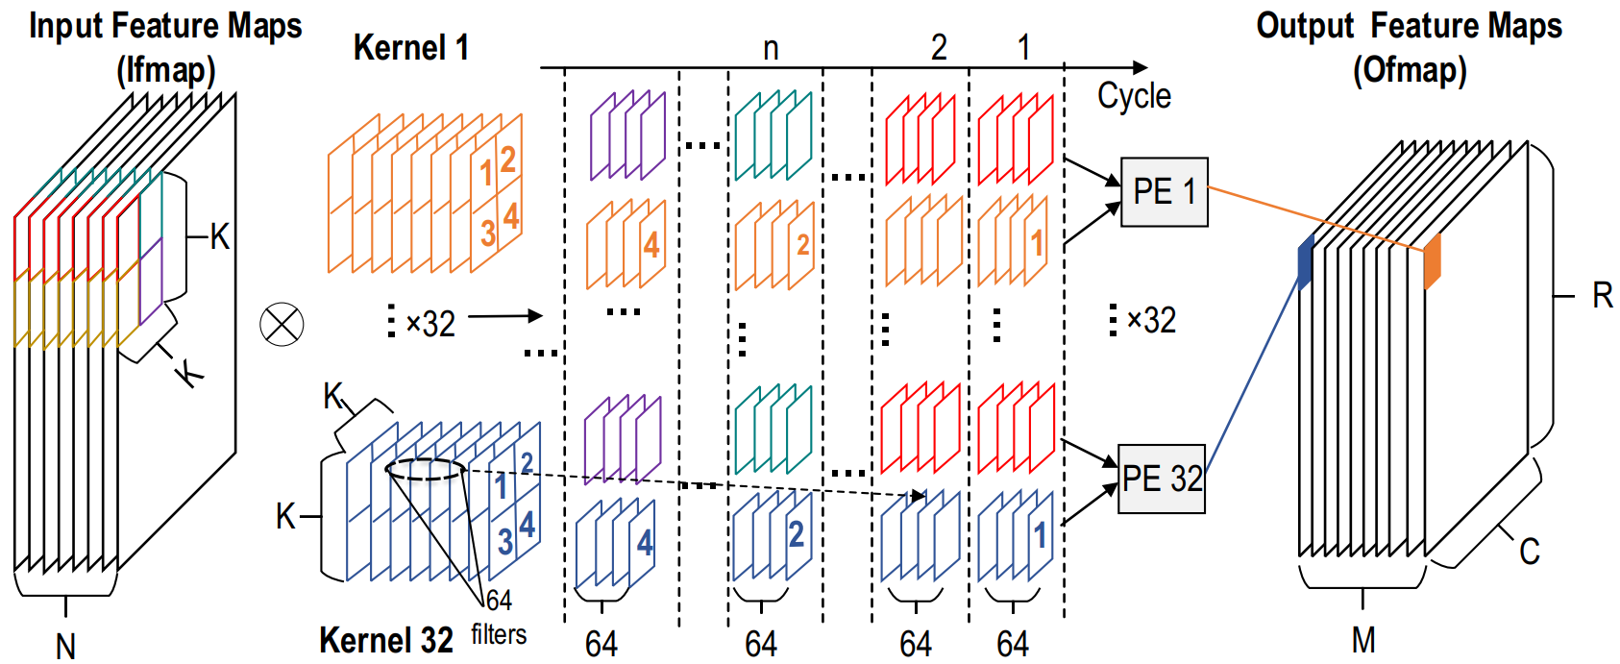
Overall architecture[2]
32 PEs work process at each cycle

Slide 41
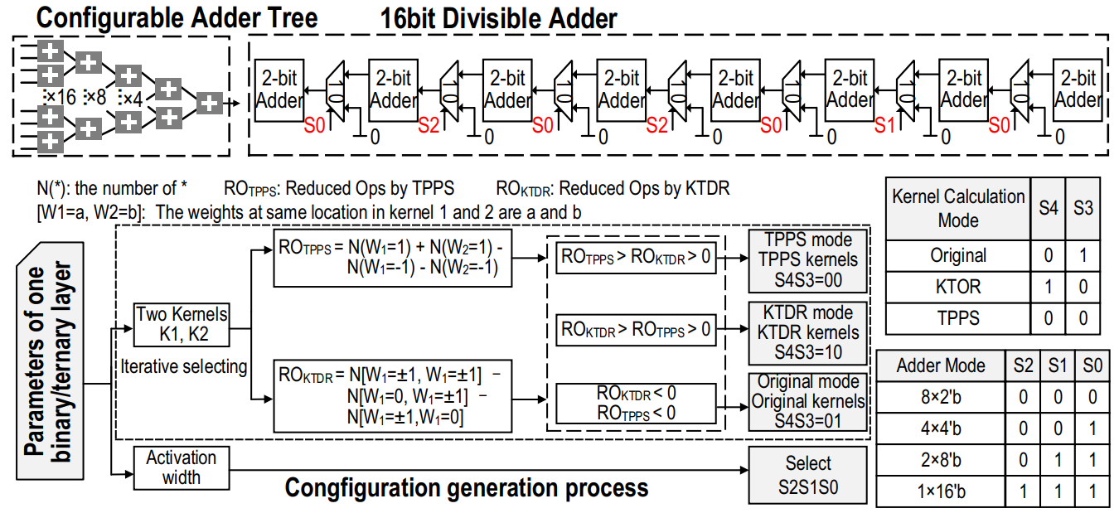
Overall architecture[3]

Slide 42
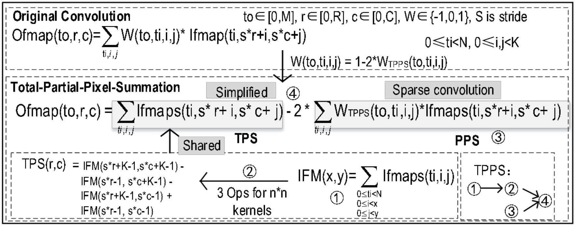
Three Technologies-TPPS[1]
Total Partial Pixel Summation
TPS is quickly computed for kernels with different size and shared by all kernels.
PPS is the convolution result of the input feature map with TPPS kernels, the sparsity of which further reduces numerous addition counts.

Slide 43
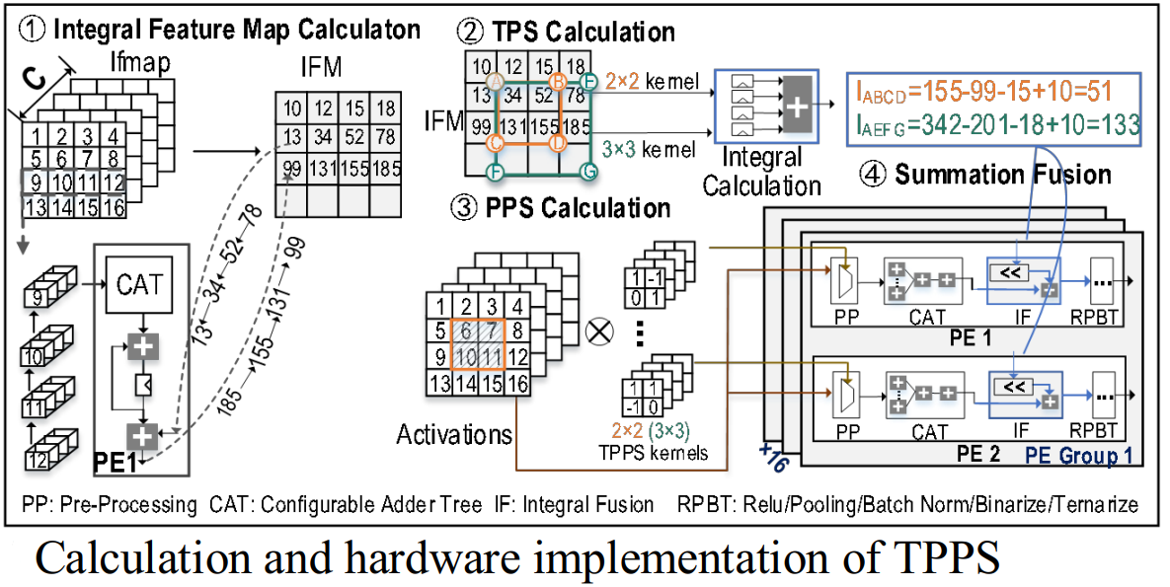
Three Technologies-TPPS[2]
Testing on AlexNet/VGG/Centerloss, TPPS decreases operations by 46.5%/45.3%/45.9% for BWN, 32.8%/35.7%/33.6% for TWN, 49.1%/46.9%/49.8% for BNN

Slide 44
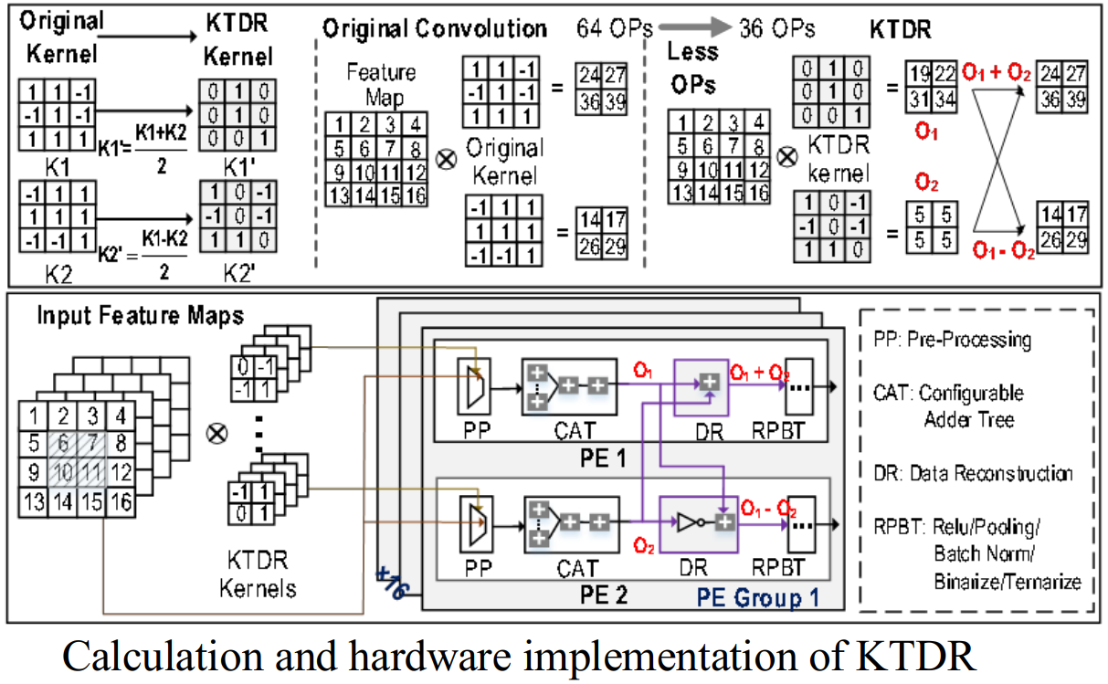
Three Technologies-KTDR
Reduce more operations due to zero weights are generated
Testing on AlexNet/VGG/Centerloss show that operations are reduced by 49.1%/49.7%/48.5% for BWN, 34.2%/37.5%/36.4%for TWN, 49.8%/49.9%/49.5%for BNN.

Slide 45
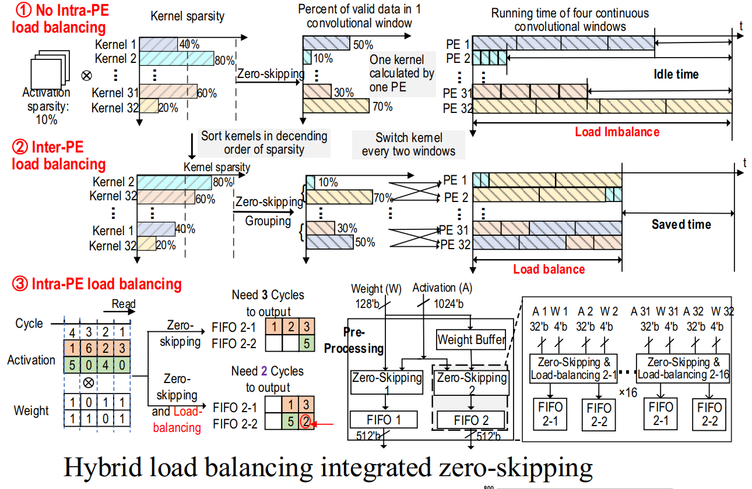
Three Technologies-HLBM
Hybrid Load-Balancing Mechanism
Sort 32 kernels
Switch two kernels
Storage balance
PE works in full load
Notes:
Two kernels are switched every two convolutional window
Each valid data is stored in the sub-FIFOs for storage balance
PE works in full load

Slide 46
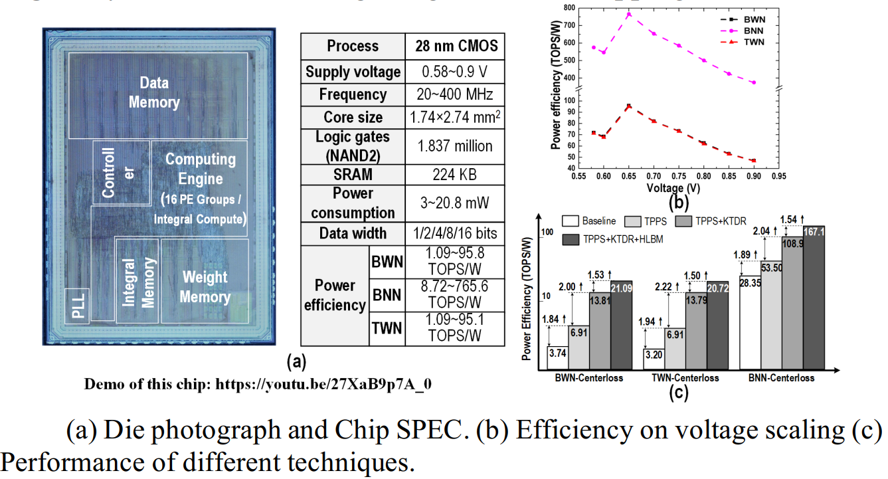
Measurement Results[1]

Slide 47
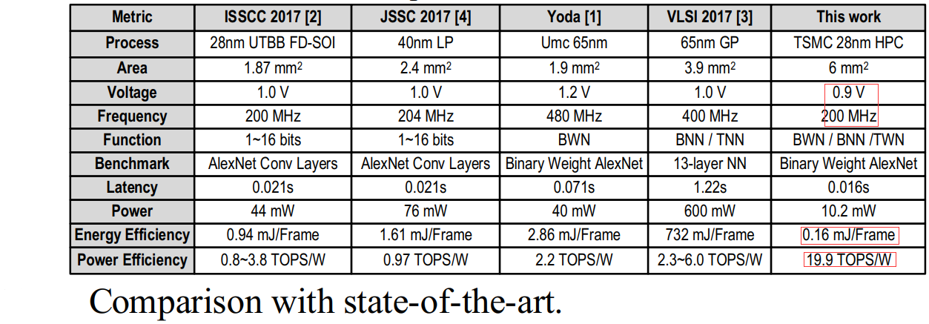
Measurement Results[2]
Comparison

Slide 48
Thank you!
Changchun Zhou
zhouchch@pku.edu.cn
School of Electronic and Computer Engineering
Peking University Shenzhen Graduate School
Shenzhen, China

